Slide 1
Contraceptive Choice Method
This project aims at understanding which is the most preferred contraceptive method choice

Slide 2
Introduction
Contraceptive can be defined as a device or drug that can be used to prevent pregnancy due to sexual intercourse.
There are various Contraceptive Method Choice that can be used by anyone to prevent pregnancy.
Understanding women’s contraceptive method choices is key to enhancing family planning services provision and programming in the society.
Therefore, this project aims at understanding which is the most preferred contraceptive method choice.

Slide 3
Dataset Details
This dataset is a subset of the 1987 National Indonesia Contraceptive Prevalence Survey.
The dataset contains 9 attributes and 1473 records.
The samples are married women who were either not pregnant or do not know if they were at the time of interview.

Slide 4
Sources.
Origin:
This dataset is a subset of the 1987 National Indonesia Contraceptive Prevalence Survey
Creator: Tjen-Sien Lim (limt '@' stat.wisc.edu)
Donor: Tjen-Sien Lim (limt '@' stat.wisc.edu)
https://archive.ics.uci.edu/ml/datasets/Contraceptive+Method+Choice
The dataset has 1473 records that will be used to train a model that will provide which is the best Contraceptive Choice Method that is preferred in family planning.

Slide 5
Description of Columns.
Below are the attributes of the data columns that the model will rely on in preprocessing the most preferred Contraceptive method used.
Wife's age (numerical)
Wife's education (categorical) 1=low, 2, 3, 4=high
Husband's education (categorical) 1=low, 2, 3, 4=high
Number of children ever born (numerical)
Wife's religion (binary) 0=Non-Islam, 1=Islam
Wife's now working? (binary) 0=Yes, 1=No
Husband's occupation (categorical) 1, 2, 3, 4
Standard-of-living index (categorical) 1=low, 2, 3, 4=high
Media exposure (binary) 0=Good, 1=Not good
Contraceptive method used (class attribute) 1=No-use, 2=Long-term, 3=Short-term

Slide 6
Project Deliverables.
The objective of the project is to;
Build a model that predicts what is the most suitable contraceptive method choice.
To predict the current contraceptive method choice (no use, long-term methods, or short-term methods) of a woman based on her demographic and socio-economic characteristics.

Slide 7
Library Imports
import pandas as pd
import numpy as np
import seaborn as sns
import matplotlib.pyplot as plt
from sklearn.feature_selection import SelectKBest, f_classif
from sklearn.model_selection import train_test_split
from sklearn.discriminant_analysis import LinearDiscriminantAnalysis as LDA
from sklearn.ensemble import RandomForestClassifier
from sklearn.linear_model import LogisticRegression
from sklearn.neighbors import KNeighborsClassifier

Slide 8
Library Imports
from sklearn.tree import DecisionTreeClassifier
from sklearn.svm import SVC
from sklearn.metrics import classification_report, accuracy_score, precision_score, recall_score,f1_score
from sklearn.model_selection import GridSearchCV
from sklearn.metrics import confusion_matrix
import pickle
import sklearn as sk
import warnings

Slide 9
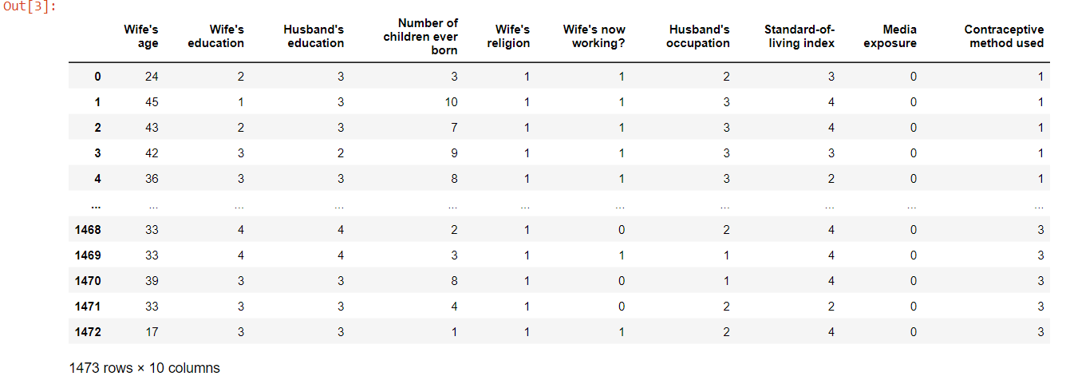
DataFrame Snippets

Slide 10
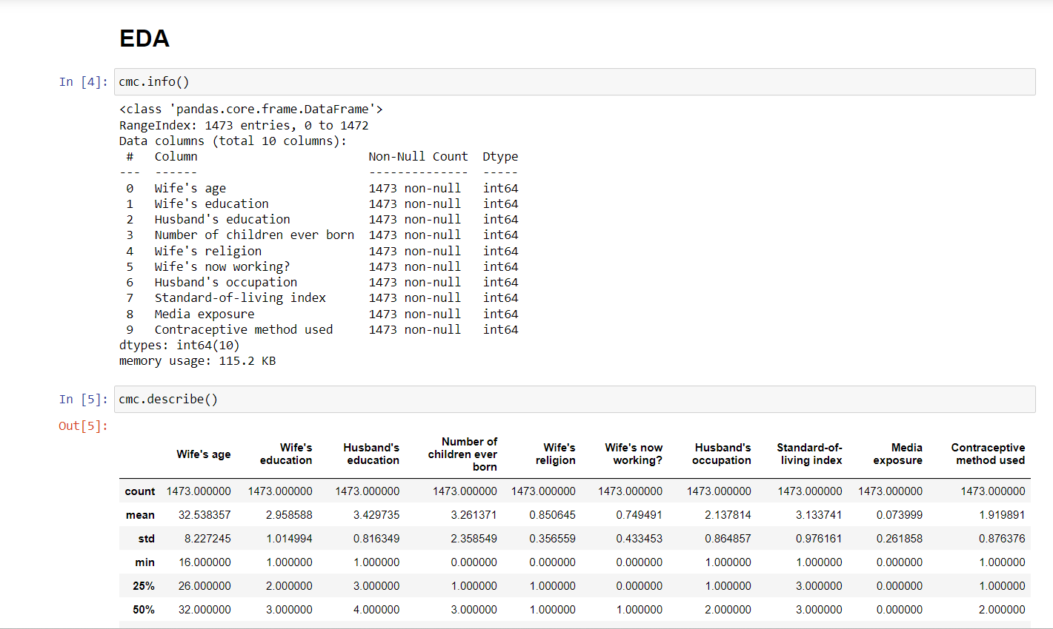
EDA

Slide 11
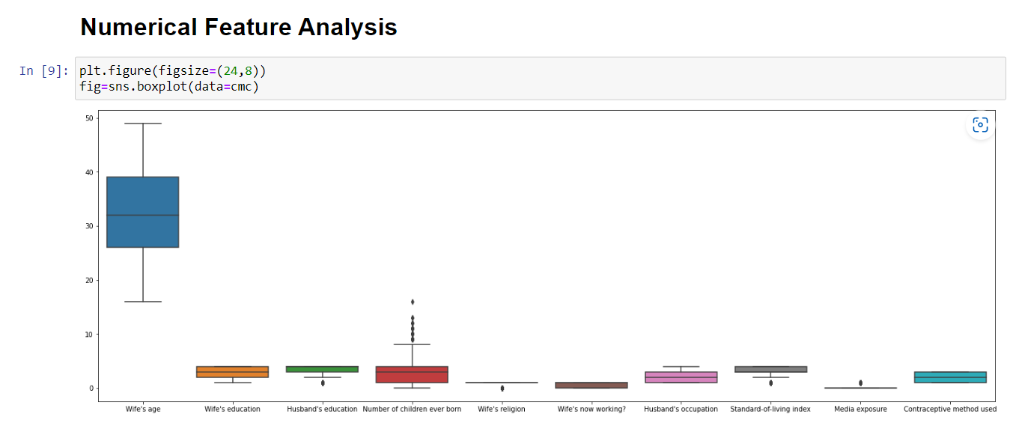
Numerical Feature Analysis.

Slide 12
Observation on Results.
The data has 1473 intances.
The data has no missing values.
The target variable which is 'Contraceptive Method Used’.
The following columns; Husband's education, Number of children ever born, Wife's religion, Standard-of-living index and Media exposure have outliers and require further analysis.

Slide 13
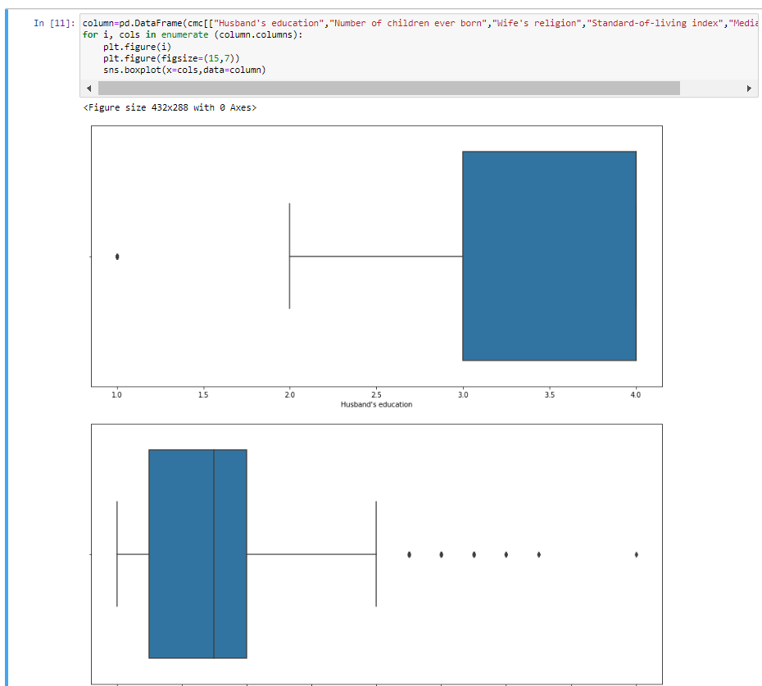
Outliers in the Dataset.

Slide 14
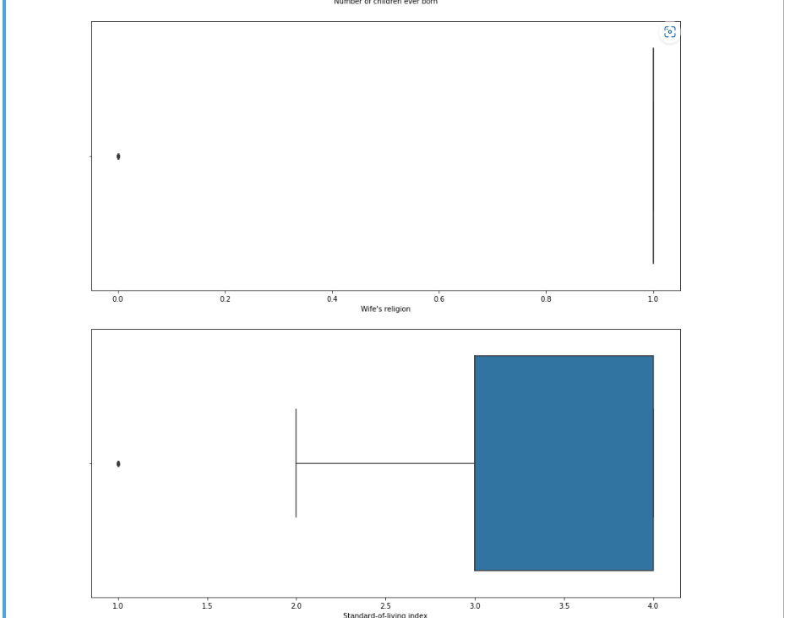
Outliers in the Dataset.

Slide 15
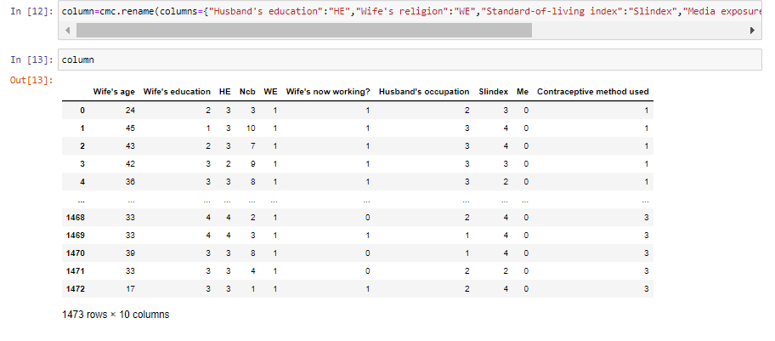
Renaming of some columns

Slide 16
Observations.
The data has 1473 intances.
The data has no missing values.
The target variable which is 'Contraceptive Method Used’.
The following columns; Husband's education, Number of children ever born, Wife's religion, Standard-of-living index and Media exposure have outliers and require further analysis.

Slide 17
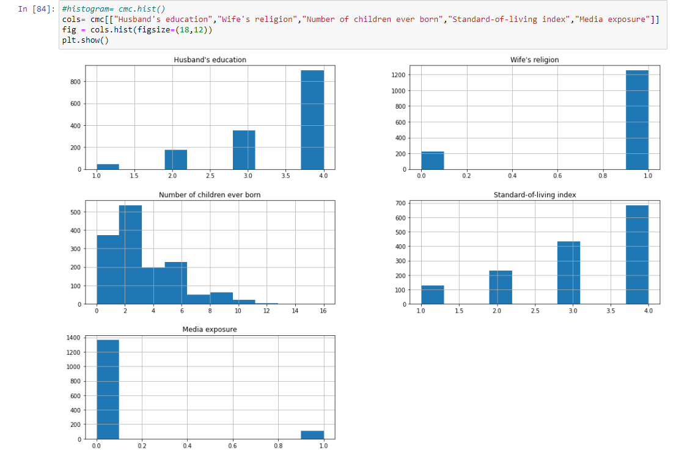
Observation of data with outliers on an histogram

Slide 18
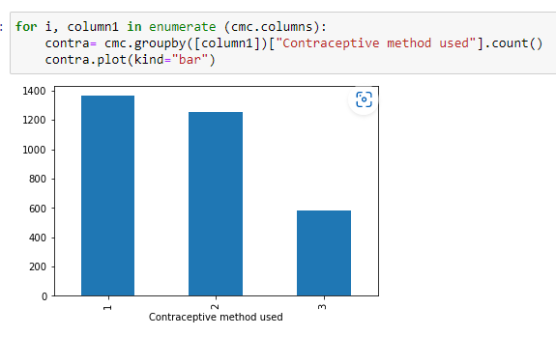
Observation on results
The columns; Husband's education, Wife's religion and Standard-of-living index has outliers on the lower side.
The most preferred method as from the below plot indicates that method 1 (No-use) of the Contraceptive method used is most preferred. Method 3 (Short-term) is the least preferred.

Slide 19
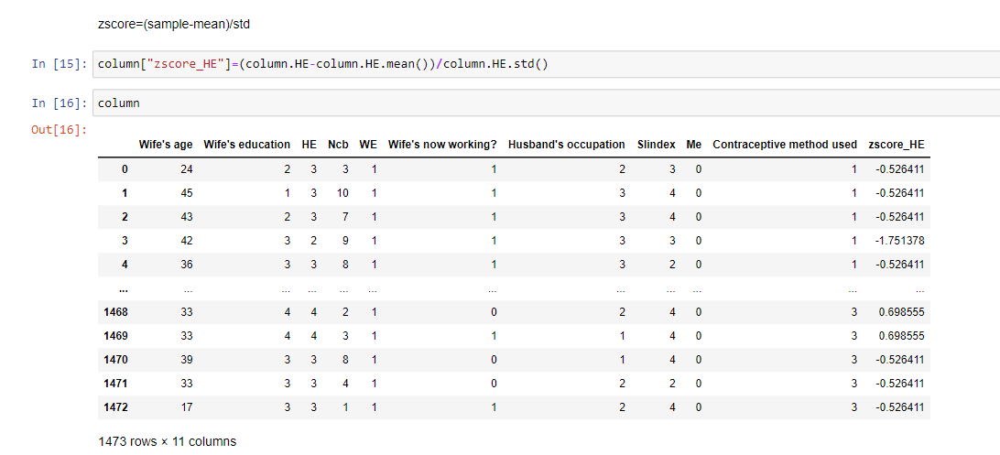
Preprocessing
The zscore method will be used to handle outliers from the identified columns of the dataset.

Slide 20
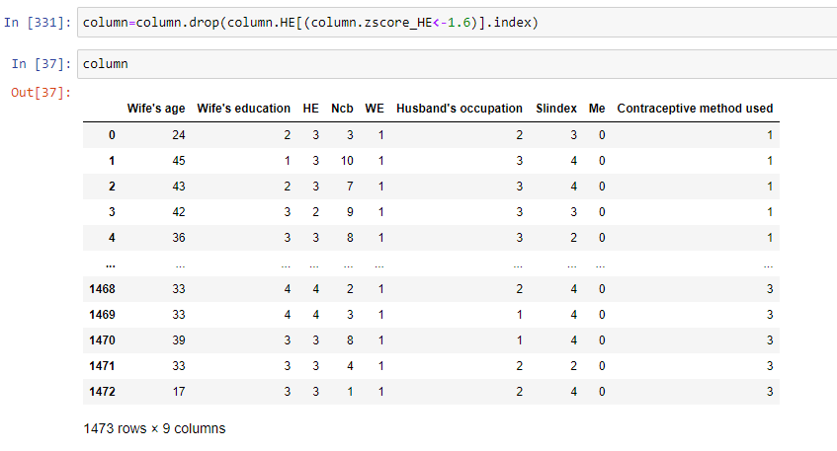
Snapshots of the zscore method.

Slide 21
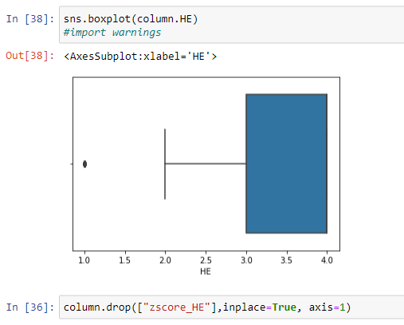
Observations from the zscore method.

Slide 22
Observations from the zscore method.
If you drop data from one column (Slindex), it will also drop outliers in other columns and therefore, I have used the HE(formerly Husband’s education) column to preprocess the model.
The HE column has been used to therefore drop the existing outliers in the data.

Slide 23
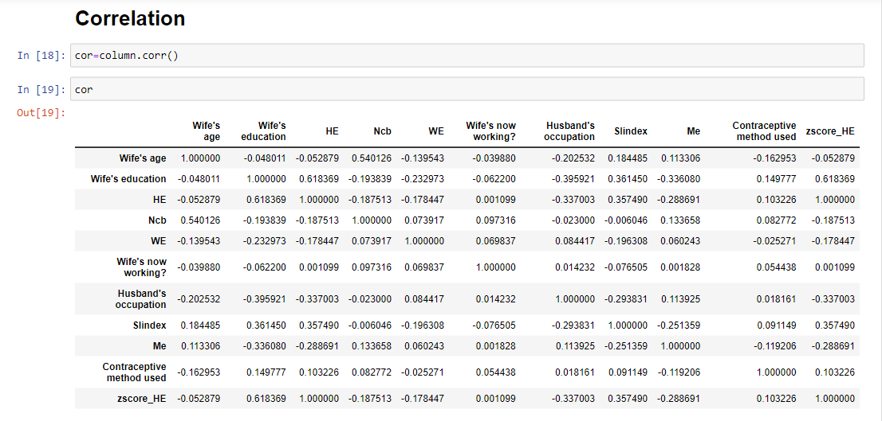
Correlation

Slide 24
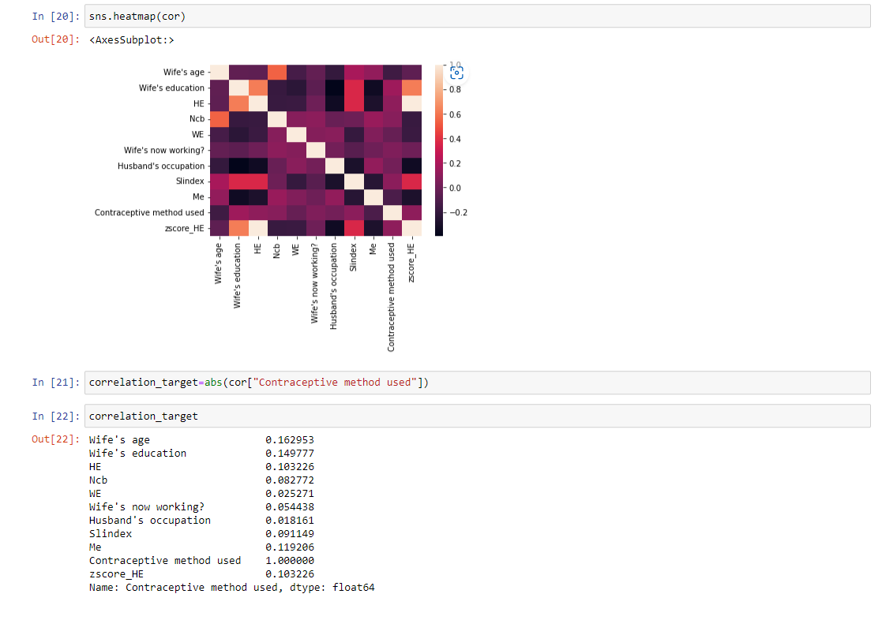
Heatmap

Slide 25
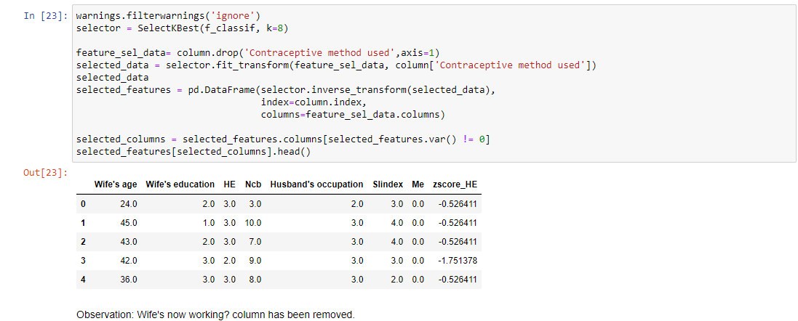
Feature Selection- Univariate feature selection.

Slide 26
Observation.
The Wife's now working? column has been removed.

Slide 27
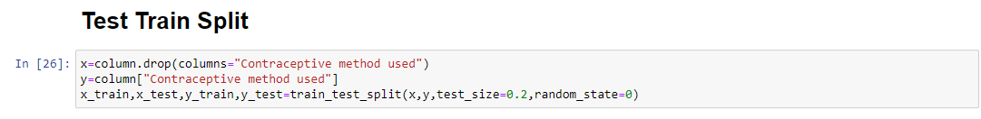
Test-Train split ratio 80:20

Slide 28
Model Creation
The project is a classification problem, thus various classification models were used including
Logistic
SVC
K Nearest Neighbors
Random Forest
Decision Tree
LDA

Slide 29
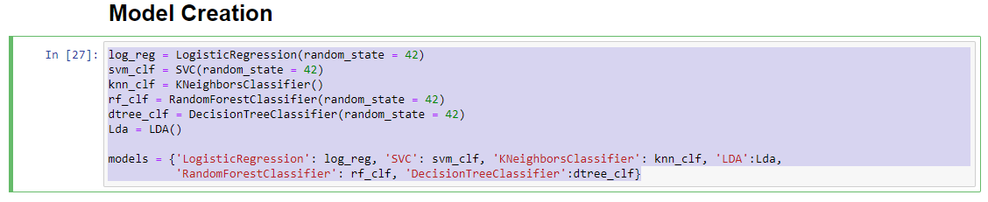
Model Creation

Slide 30
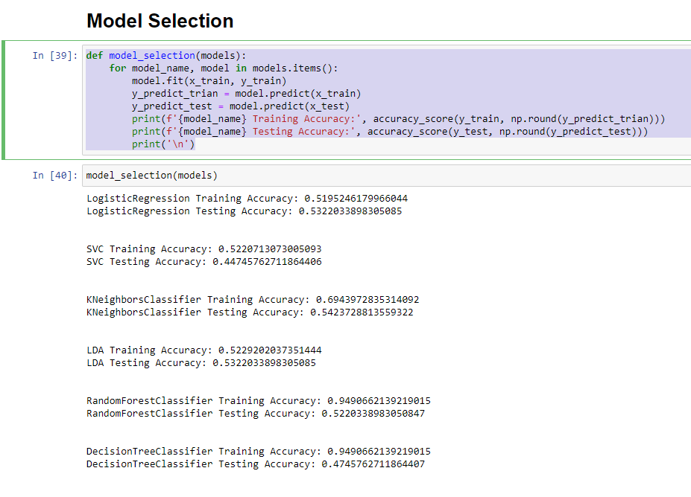
Model Selection

Slide 31
Observations
The above models are executed to identifying the most correct model that can be used to predict the most preferred Contraceptive method used.

Slide 32
Hyper-Parameter tuning SVC classifier
With SVC as the preferred choice hyper parameter tuning is done
Some of the hyper parameters include
SVC
No-use
Long-term
Short-term

Slide 33
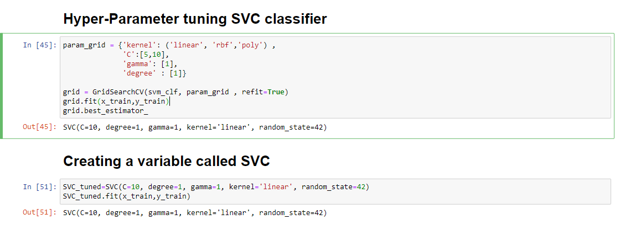
Hyper-Parameter tuning SVC classifier

Slide 34
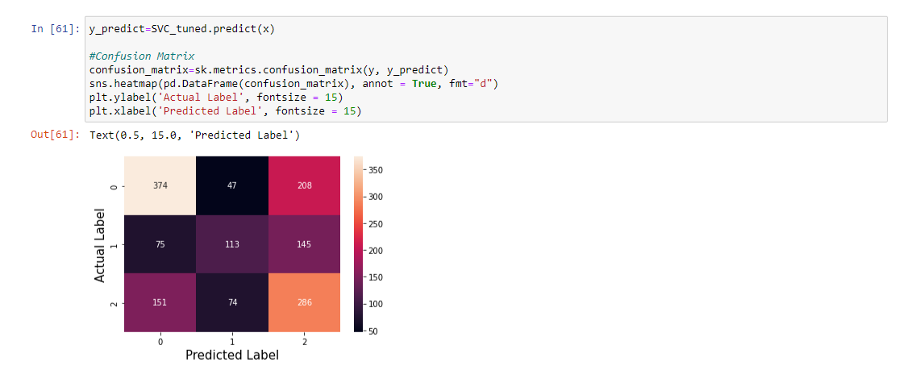
Evaluation

Slide 35
Observations
The actual data on column and predicted on the row.
Women using contraceptives are 374 while method 1 was 47.
Those not using a short term method 2 is 20.

Slide 36
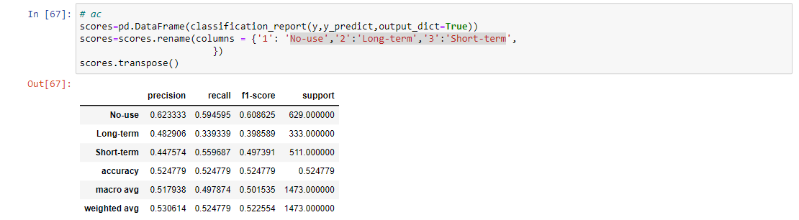
Evaluation

Slide 37
Evaluation Observation
From the evaluation of the previous slide;
Precision the ratio of true positives divided by the false positives plus the true positives which tranlates to 62%.
Recall indicates how correctly the model finds the true positives with 59%.
Support is the number of instances found on No-Use 629 that has been found correctly by the model.

Slide 38
Conclusion
There are key conclusions on the build up model and it underwent every design and development to indicate that;
The SVC Model is the best for this project.
More data is required in order to improve the prediction.
Based on a woman's demographic and socio-economic characteristics, the most preferred contraceptive choice method was no-use with a total of 374 instances.
FIN.

